Slide 1
OOPS Project
University database management system
Group Members:
Tarun Talreja - 180907632
Krishna Jayakumar - 180907754
Parth Sirohi - 180907516
Chintan Rout - 180907544
Rithika Iyer - 180907520

Slide 2
Project Aim
•The aim of this project is to create a University database management system by compiling the data related to students and the faculty members.
Outlined in the slides below are details and concepts pertaining to our project

Slide 3
Hierarchical Segmentation Between the Classes
Class Database
Class Faculty
Class Student
Class Masters

Slide 4
Student and Database Classes
Members of Class
Member Functions
•Name
•Age
•Gender
•Birth Year
•Roll Num
•Unique ID
•Role
Create();
Display();
Modify();
Database
Create();
Display();
Print StudentDB();
Modify();
Update Grades();
Grade Summary();
Print Department();
Write To File();
Print Basic Data();
Get Faculty Department();
•Section
•Grades[6]
•Subj 1,2,3
•Batch Year
•Student Count
Student

Slide 5
Master and Faculty Classes
Create();
Display();
Print FacultyDB();
Modify();
Write To File();
Get Student Grades();
Faculty
•Salary
•Department
Create();
Display();
Print MastersDB();
Modify();
Write To File();
Update Master Grade();
Print Departments();
Masters
•Salary
•Department

Slide 6
University Database Menu
Case-1
Case-2
Case-3
Case-4
Student DB
Faculty DB
PhD DB
Exit

Slide 7
Student Menu
Case-1
Case-2
Case-3
Case-4
Case-5
Case-6
New Entry
Print all Entries
Print Single Entry
Modify Entry
Update Grades
Grade Summary
Case-7
Case-8
Case-9
Case-10
Print Public Data
Exit
Update Database to File
Professor Department
Notes:
One circle/func , will be marked as different color indication that its a friend function.

Slide 8
Faculty Menu
Case-1
Case-2
Case-3
Case-4
New Entry
Print all Entries
Print Single Entry
Modify Entry
Case-5
Case-6
Case-7
Exit
Update Database to File
Grade Summary of Student
Notes:
One circle/func , will be marked as different color indication that its a friend function.

Slide 9
Masters/PhD Menu
Case-1
Case-2
Case-3
Case-4
Case-5
Case-6
New Entry
Print all Entries
Print Single Entry
Modify Entry
Update Grades
Print Public Data
Case-7
Case-8
Case-9
Print Public Data
Exit
Update Database to File
Notes:
One circle/func , will be marked as different color indication that its a friend function.

Slide 10
Output Windows

Slide 11
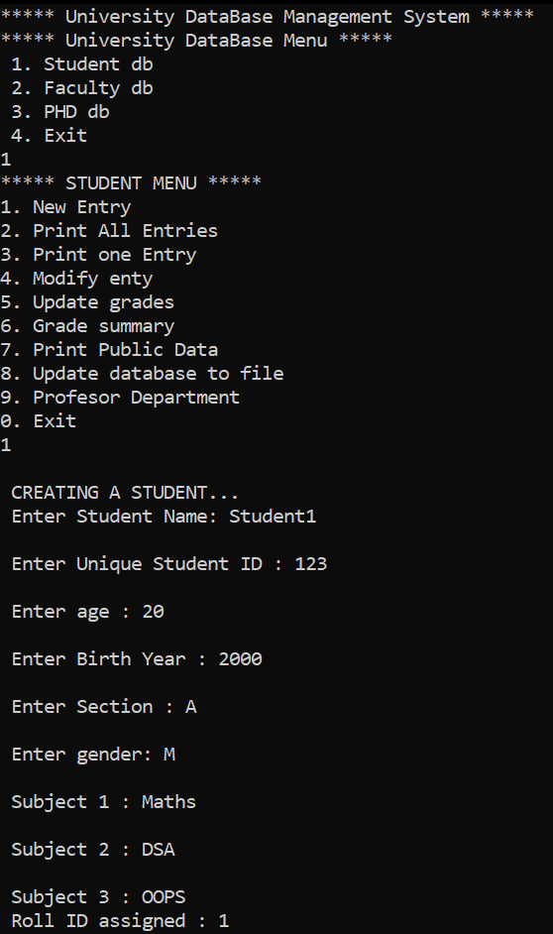

Slide 12
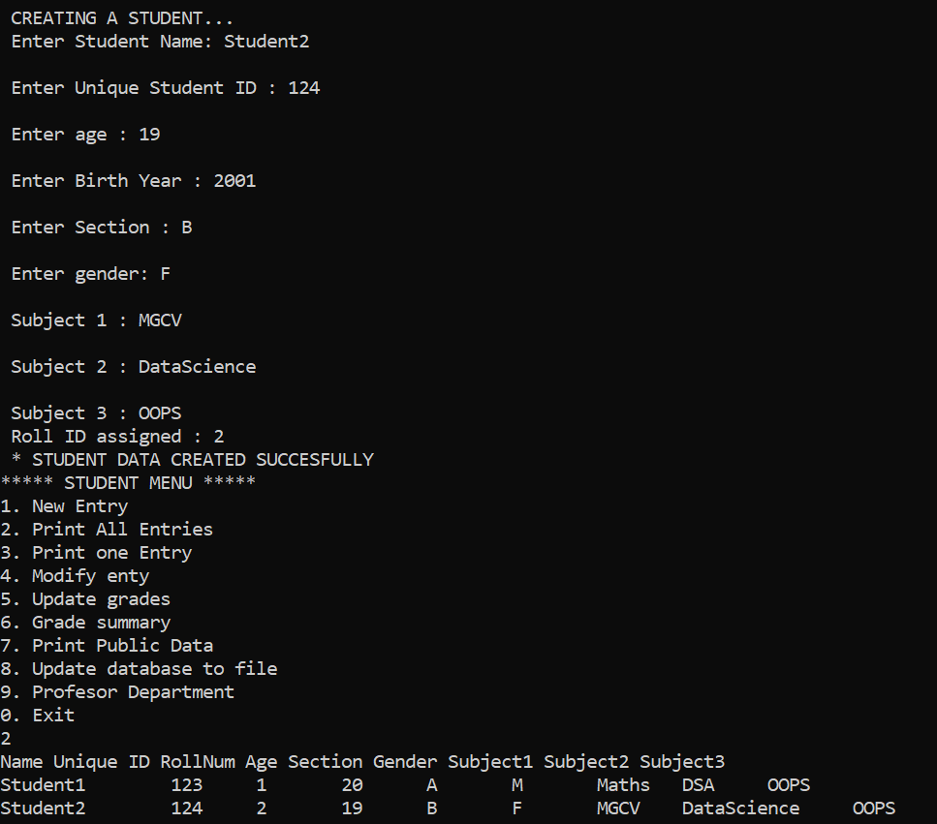

Slide 13
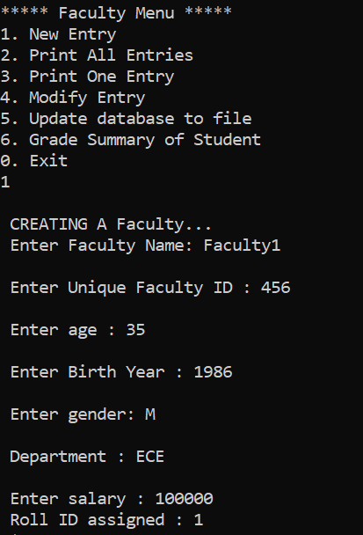

Slide 14
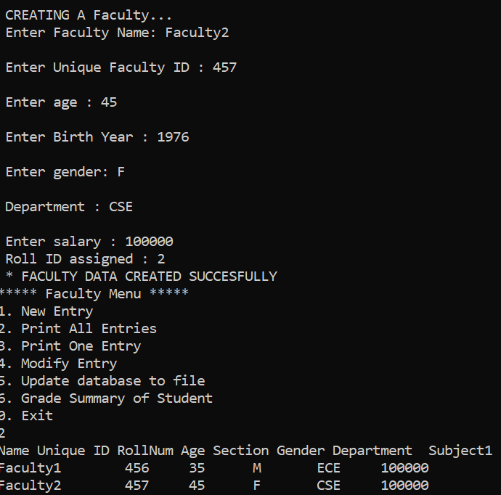

Slide 15
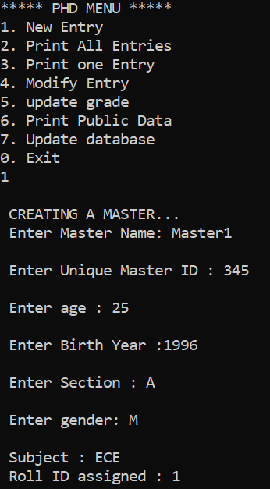

Slide 16
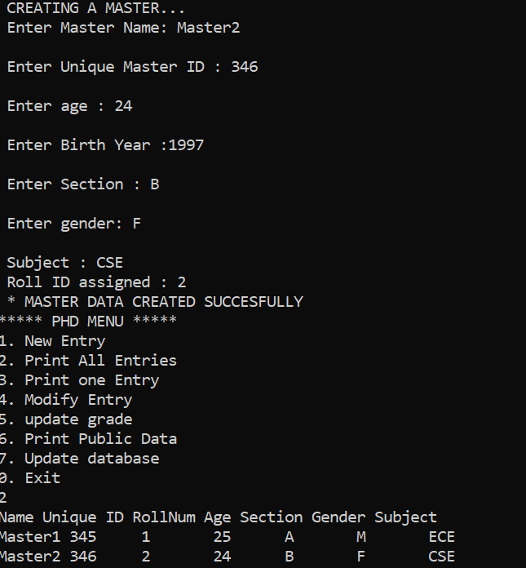

Slide 17
